Slide 1
VA Central IRB
CSP NSCs, PMs, and NODES Managers
Don E. Workman, Ph.D., VA IRB Network Director
Christie O’Brien, VA Central IRB Manager
Jeff Newcomb, BS, ACRP-PM, CCRC, National Study Coordinator
Angela Foster, VAIRRS Program Manager
March 31, 2021 ∙ April 8, 2021
Dial in (Main): (404) 397-1596
Attendee Access Code: 199-755-3537
Slides available on SharePoint:
See link in Q&A Box

Slide 2
Topics
  Bottom Line Up Front
  CIRB Process Changes
  IRBNet Terms
  Accessing IRBNet and Enrolling
  CIRB Project Shells (PI and LSI)
  Granting Access to a Project
  Multi-site Sharing
  IRBNet Demonstration
    Complete a project shell
    Create New Project
    Multi-site Sharing

Slide 3
BLUF
  Who should register for an IRBNet account?
    All PIs, LSIs, and study team members must register for an IRBNet account at gov.irbnet.org
    Anyone who will need to collaborate on the submission
    Any study team member that needs to track training
    Anyone who needs insight into the project (does not include oversight committees)
  IRBNet supports the collaboration of Central Teams
    CIRB will automatically transfer ownership of the project to PI or LSI only
    The PI or LSI is the owner of the project and is responsible for granting access to the study team
  Once you are granted access to the project, you will have access to all packages for that project
    PI, LSI, or designee must ‘share’ the project with the individual who requires access
    Once shared, you may access the Project History, review details, and board actions

Slide 4
CIRB Process Changes
COI
  CIRB is no longer reviewing the OGC 450 Alt-VA.
  Do not submit the Form OGE 450 Alt-VA. Include the COI determination with submission.
  The VA Central IRB Form 102 is under modification to add statement regarding COI review
  If your facility does not have a COI Committee or COI Administrator, you should use the same mechanism that is used for studies not under the oversight of the CIRB.
Submission workflow
  New project submissions must be submitted to your local research administration for active VAIRRS sites
  Initial submissions may be submitted directly to the CIRB for sites not active in VAIRRS
  All subsequent submissions (CR, Amendments, Reportable Events) may be submitted directly to the CIRB
SharePoint
  The CIRB SharePoint portal no longer accepts new projects
  SharePoint will remain for meeting minutes and as a reference/document storage until study documents are transferred to IRBNet

Slide 5
CIRB Process Changes
Forms
  The CIRB Form 108 (PI Initial submission) and Form 104 (LSI Initial submission) have been incorporated into the IRB Information Worksheet
  All other CIRB forms are available in the VA CIRB Forms library
Package Signatures
  All packages must be signed using ‘Sign this Package’ by the PI/LSI or designee before submission
  ‘Designee Signature Mode’ should be used if signing on behalf of the PI/LSI
Continuing Review
  Central Teams may still coordinate CR submissions
  The PI and each LSI site are required to submit a CR package using the converted CIRB project shell with the unique IRBNet ID assigned to that site
  Each site will complete and submit the VA Central Form 115B using the project shell for that site
15-Day Waiting Period
  CIRB no longer requires the 15-day waiting period for submissions in IRBNet.

Slide 6
IRBNet Terms
Share – Sharing is the action of granting access to a project.
  The PI/LSI or designee with full access can share the project with any IRBNet user account
  The PI or designee with full access can ‘Multi-Site’ share the project with local sites
  The PI/LSI or designee can ‘Transfer ownership’ of the project to any IRBNet user account
Wizard/Smart-Form – primary data collection tool.
  Project Cover Sheet and IRB Information Sheet wizards
  All PI/LSIs should complete the wizards at the next study event or when the project shell is completed by the study team.
Project – Each site in a multi-site study, or a single-site study, is represented by a unique project in IRBNet.
  Multi-site projects are linked
  PI Site = Lead Site, Local Site = Non-lead Site
  The Lead Site and Non-lead Sites are granted access to the other ‘projects’ in a multi-site study
Package – Each Project can have a series of packages
  Packages represent a submission (initial review, CR, Amendment, Reportable Event)
Workspace - Each Board at an Institution has a logical ‘workspace’ to manage submissions and conduct reviews

Slide 7
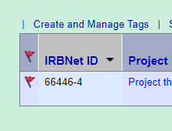
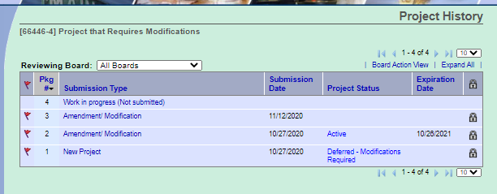
Project vs Package
Approved Project
(Package -1)
CR/Progress Report
(Package -3)
Amendment
(Package -4)
Amendment
(Package -2)
Access is granted at the Project level
Unique
Identifier
Subsequent
Packages

Slide 8
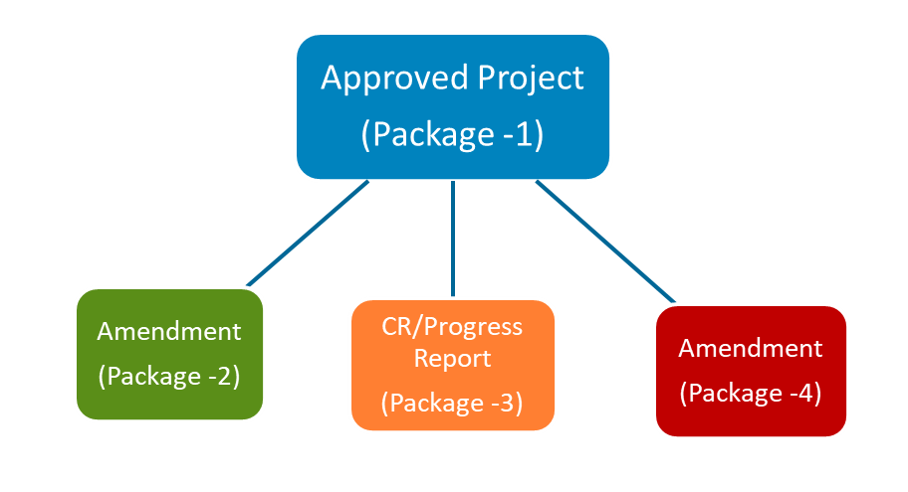
Project vs Package – Multi-site
PI (Lead Site)
Site A (Non-lead Site)
Site B (Non-lead Site)
Site C (Non-lead Site)

Slide 9
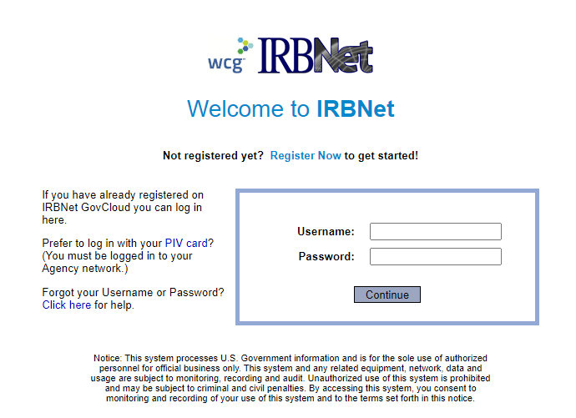
Accessing IRBNet
Website address:
  gov.irbnet.org
  VA’s instance of IRBNet
    NOT NRN Network’s instance
  PIV Login
  Accessible from outside the VA network

Slide 10
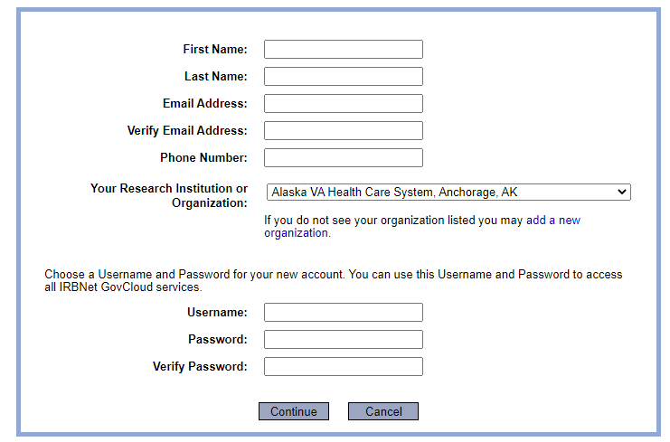
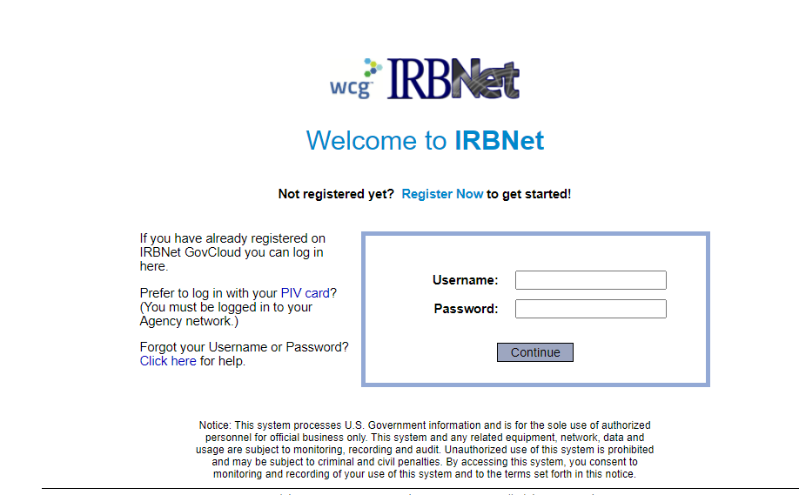
Enrolling in IRBNet
All VA facilities are listed under Research Institutions

Slide 11
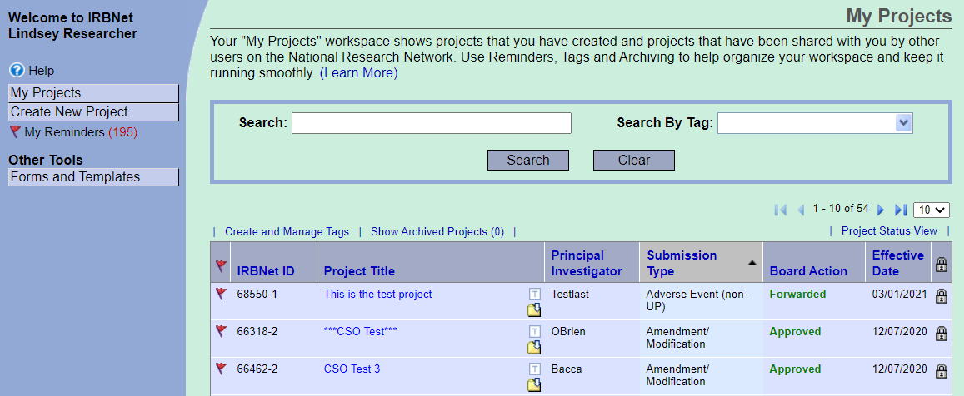
CIRB Project Shells
Project Shells are projects with no review history or study documents
CIRB converted the latest CIRB board action for active studies into project shells
The PI and each approved LSI will have a converted project shell
We attempted to assign ownership to the PI/LSI
Notify CIRB if the PI/LSI is registered and cannot access their project shell under ‘My Project’
CIRB will transfer ownership to PI/LSI

Slide 12
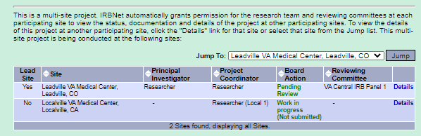
CIRB Project Shells – Multi-site Projects
Multi-site projects are linked in IRBNet
View all sites in ‘Project Overview’
  Open project by clicking Project Title link
  Scroll to bottom of Project Overview page
Select the Details link to view the Lead Site or Non-lead site project details

Slide 13
CIRB Project Shells - Reconciliation
Duplicate projects can be reconciled in IRBNet if the local version has completed reviews
Step 1 | Contact angela.foster@va.gov or the CIRB Manager responsible for the project
------ DO NOT MOVE FORWARD UNTIL YOU CONTACT THE CIRB -----
Step 2 | PI/LSI or designee will submit the local version of the project to the CIRB Submission Type = ‘Other’ Add comment (ex. This is the local version of a converted project) Attach approved study documents
Step 3 | CIRB will administratively review the local version of the project
Step 4 | CIRB will unlink the CIRB project shell from the multi-site project
Step 5 | CIRB will link the local version of the project to the multi-site project
Step 6 | CIRB will ‘Withdraw’ the converted CIRB project shell

Slide 14
Completing a Project Shell
Completing a project shell is the process of uploading study documents to an empty project shell
  Option 1: CIRB will complete empty project shells over the next three months
  Option 2: What happens if you need to submit a new package now?
    ‘Create a New Package’ using the converted project shell
    Complete the Project Cover Sheet and IRB Information Sheet wizard
    Include all approved study documents with submission
  Option 3: The study team may choose to complete the project shell now, even if there is no action.
    ‘Create a New Package’ using the converted project shell
    Complete the Project Cover Sheet and IRB Information Sheet wizard
    Include all approved study documents with submission
    Submit package to CIRB
      Submission Type = ‘Other’
      Include note (ex. “Submitting completed project shell)

Slide 15
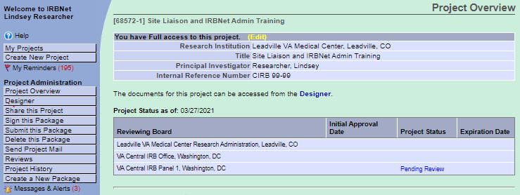
Granting Access to a Project
Step 1: Open the project by clicking the Project Title link
Step 2: Select the ‘Share this Project’ menu item
Step 2

Slide 16
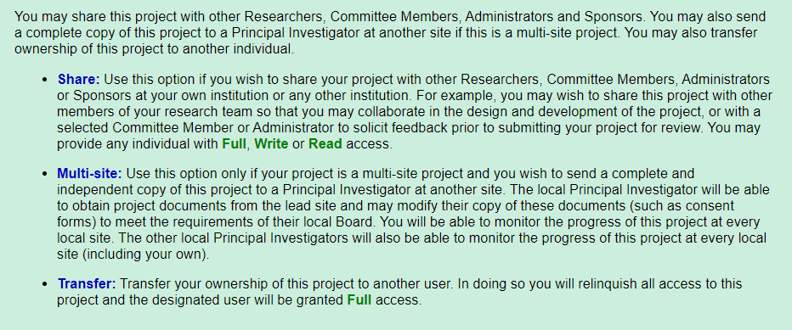
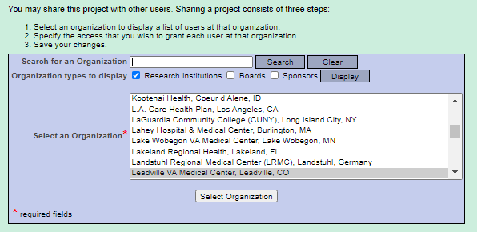
Granting Access to a Project
Step 3: Select the ‘Share’ link
Step 4: Search for user’s research organization
  Select Organization

Slide 17
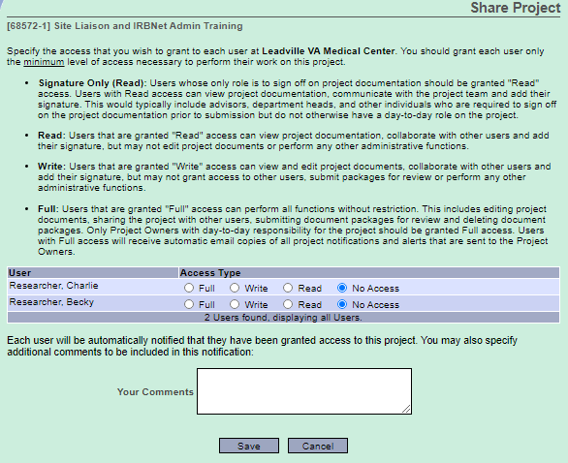
Granting Access to a Project
Step 5: Select user’s name
  and Access Type
Step 6: Select Save

Slide 18
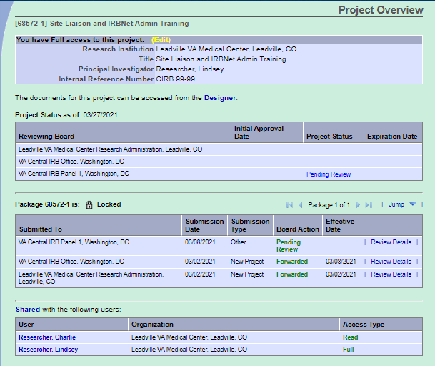
Viewing who has Access to a Project
Step 1: Open Project
Step 2: Scroll to ‘Shared with the following users’ section on Project Overview page

Slide 19
Multi-site Sharing
The PI may add local sites to a project using the ‘Multi-Site’ sharing function
  Does not apply to converted local site projects in a multi-site study
Step 1 – Open Lead Site (PI) project by clicking the Project Title link on the ‘My Projects’ page
Step 2 – Select Share this Project menu option
Step 3 – Select Multi-Site link

Slide 20
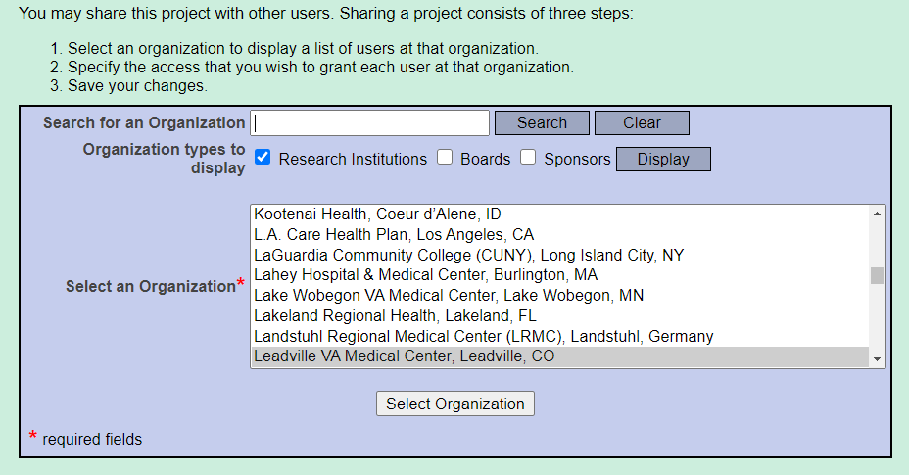
Multi-site Sharing
Step 4 – Enter the local site’s research organization and Select

Slide 21
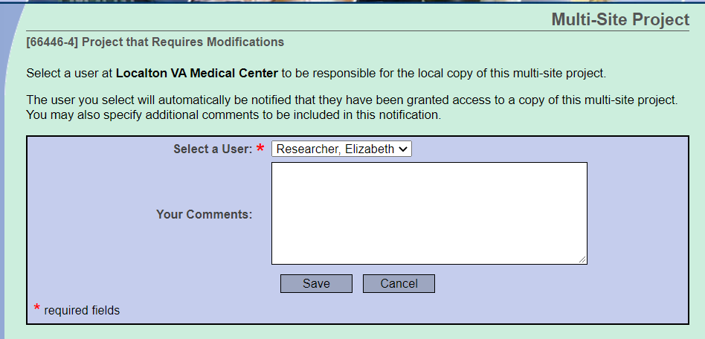
Multi-site Sharing
Step 5 – Select the LSI’s name and Save

Slide 22
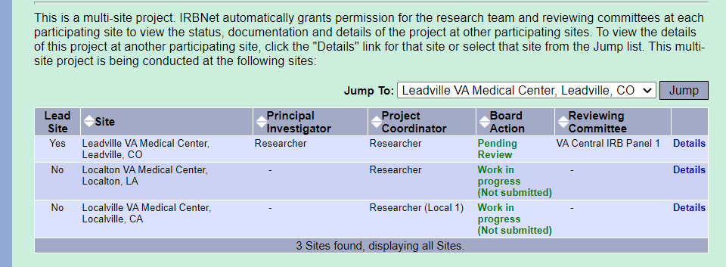
Multi-site Sharing
Step 6 – A new project is created for the LSI in their workspace
Step 7 – LSI or designee completes the new project, signs package, and submits to CIRB

Slide 23
Multiple Packages
A package may be submitted to multiple boards for parallel review.
Once a new package is started (work in progress), a second new package cannot be created for the same project until the first package is submitted or deleted.
  In this case, the Committee Administrator can create a ‘Special Events Package’ for the study team to complete and submit.
A project may have more than one package pending review (i.e. the researcher submits a CR that is pending review and then creates and submits a reportable event package)
Amendment
(Package -2) Work in Progress
Approved Project
(Package -1)
CR
(Package -3) Work in Progress

Slide 24

IRBNet Demonstration
Complete a project shell
Create New Project
Multi-site Sharing
Organizing your workspace

Slide 25
Additional Guidance
All guidance documents will be posted in the Forms and Templates library
VAIRRS SharePoint Portal: https://dvagov.sharepoint.com/sites/VHAORPPE/VAIRRS
VAIRRS Website: https://www.research.va.gov/programs/orppe/vairrs/default.cfm
For questions regarding local submission procedures:
  Contact your local research office
For questions related to CIRB processes:
  Contact the IRB Manager
For questions related to the VAIRRS program:
  Contact VAIRRS Team at VAIRRS@va.gov
For technical issues with IRBNet:
  Contact IRBNet Support at govsupport@irbnet.org

Slide 26
Availability of Recording
A recording of this session and the associated handouts will be available on ORPP&E’s Education and Training website approximately one-week post-webinar
An archive of all ORPP&E-hosted webinars can be found here: https://www.research.va.gov/programs/orppe/education/webinars/archives.cfm

Slide 27

Thank You for Attending!

